Slide 2
Unis CoLaboratory - Why Make?
How can we make this the best 7 hours of a students life?
Francesca Zammarano

Slide 3
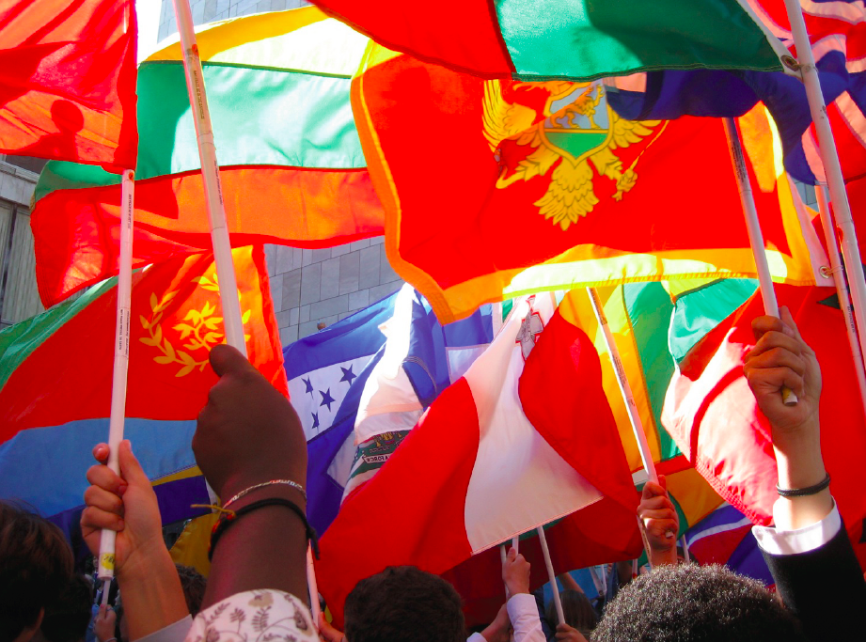

Slide 7
Today’s Workshop
1) What and why make?
2) CoLaboratory @ UNIS
3) Resources
4) Share

Slide 9
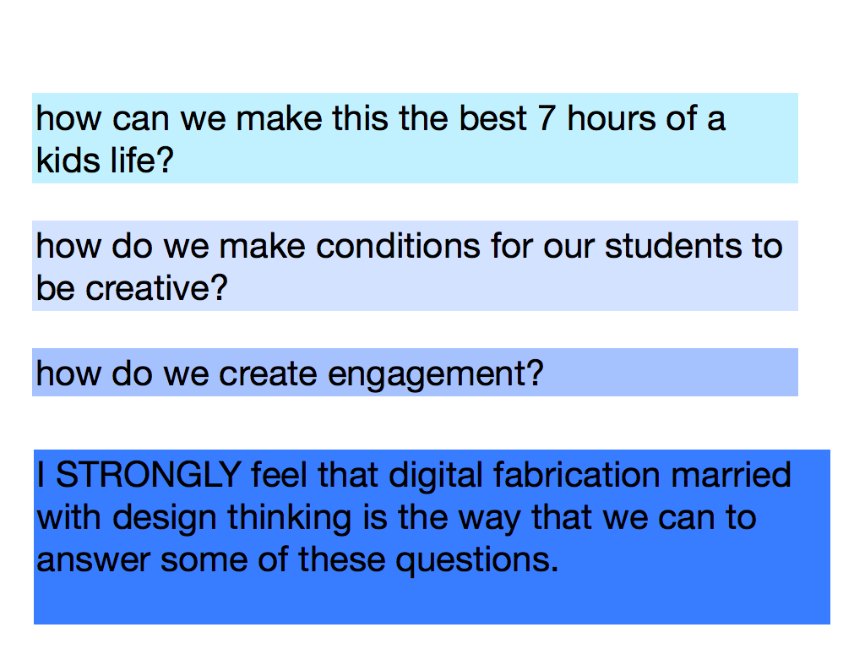

Slide 10
A safe space for students to explore their creative talents, build confidence, and make a better world through the use of the design process.

Slide 11
http://youtu.be/yxi2_o9Sopk

Slide 12
what does a maker look like?
* Sources: Nasa; “Making Makers” by AnnMaire Thomas; K-12FabLab listserv

Slide 13
“A maker mindset (maker empowerment) is less about the development of skills, and more about the development of self and community. Students become learners who learn how to problem solve, to iterate, to take risks, to see failure as opportunity, and to make the most out of unexpected outcomes”.
Maker-Centered Learning and the Development of Self: Preliminary Findings of the Agency by Design Project, A White Paper Presented by AbD Project Zero, Harvard Graduate School of Education

Slide 14
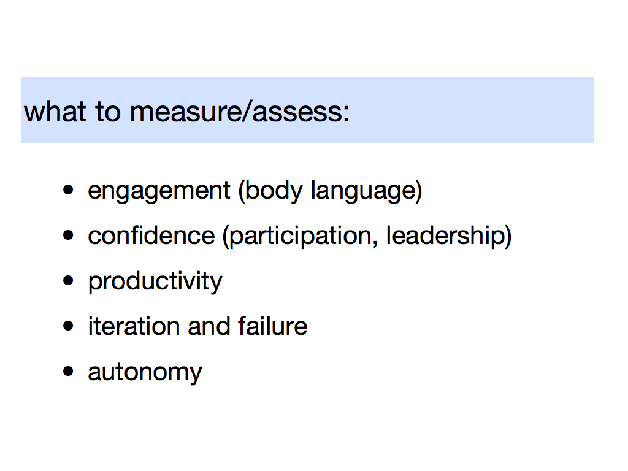

Slide 15
Core “making” principals
1) no “expert” - mutual learning experience
2) part of a community that shares
3) celebration of process, abandonment, engagement
4) open ended outcomes
5) flexible frameworks for participation
6) student driven and chaos is good!
7) maker empowerment*
* Source: Agency by Design; Maker-Centered Learning and the Development of Self: Preliminary Findings of the AbD Project

Slide 16
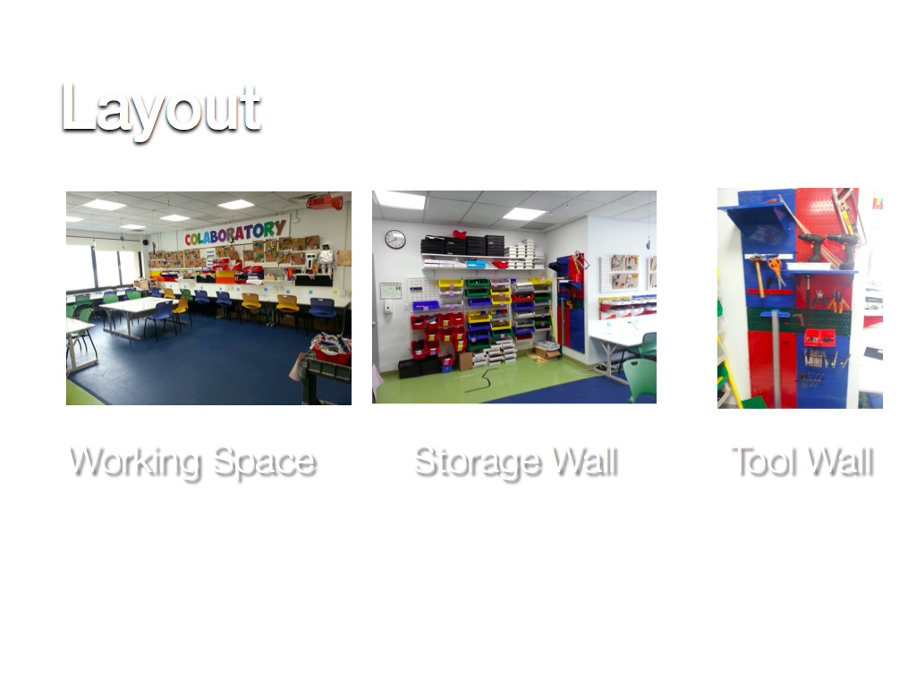

Slide 17
5 Creative Computing Strands

Slide 20
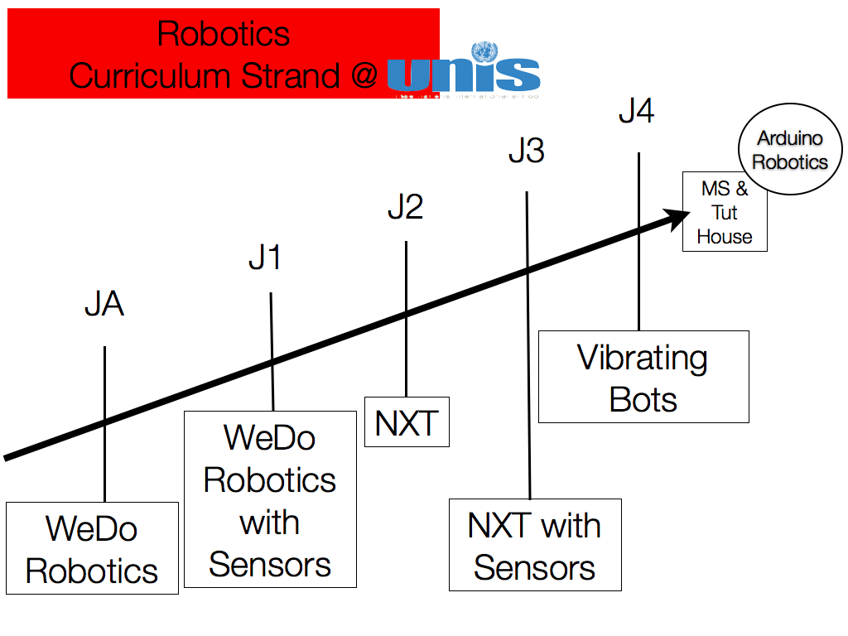

Slide 23
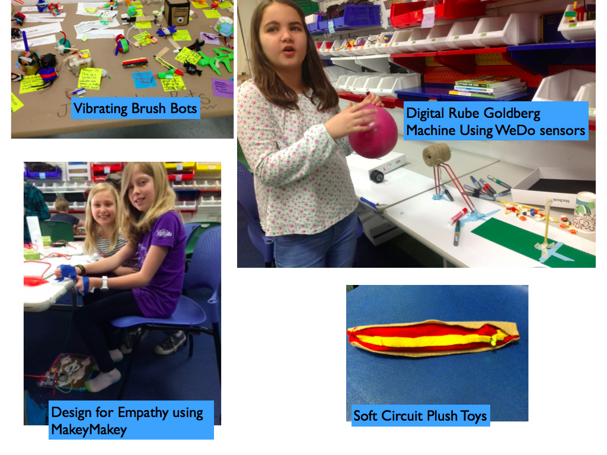

Slide 24
J4 Digital / Physical Chain Reaction Rube Goldberg Contraptions with WeDO Sensors

Slide 25
where to get materials
learn.sparkfun.com
http://curriculum.makerbot.com/
makerspace.com
www.instructables.com
inventables.com
sparkfun.com
makeprojects.com
adafruit.com/tutorials
bildr.com
http://openmaterials.org/
www.robives.com/mechs
www.makingthingsmove.com/resources
http://itp.nyu.edu/physcomp/
tinkering.exploratorium.edu
hlt.media.mit.edu

Slide 26
resources for all things!
https://sites.google.com/site/k12makers/online-resources
Shared Google folder for you, email me if you would like me to share: fzammarano@unis.org

